Slide 1
NVMe Specifications Data Structures (4.4 & 4.6)
NILKANTHA BHATTACHARJEE

Slide 2
SGL(Scatter Gather List) SGL Descriptor types Completion Queue Entry
Contents

Slide 3
The Commands in Submission Queue & Completion Queue are limited. Though the Start LBA and number of bits we want to write that can be transferred (TransferLength) but the data will not transfer at all. We need another memory connected to the host for this task. The Data Structures that the memory going to use are- -PRP(Physical Region Page). -SGL (Scatter Gather List).
Problems While Transferring Data to Controller

Slide 4
It is a data structure in a memory that describes a data buffer. SGL contains one or more SGL segments. SGL contains one or more descriptors. SGL segments should be physically contagious.
SGL (Scatter Gather List)

Slide 5
It contains one or more segment descriptors. Host can decide the size of the SGL segments. SGL segments can describe all of the data, part of the data or none of the data or the next segment.
SGL Segments

Slide 6
SGL Data Block Descriptor. SGL Bit Bucket Descriptor. SGL Segment Descriptor. SGL Last Segment Descriptor.
SGL Descriptor types

Slide 7
It points to the data in the host memory. Size is 16 byte. It contains: - address of the data (0-7). - length of the data (8-11). -SGL identifier (15).
SGL Data Block Descriptor

Slide 8
It is used for transferring non-contagious data. Size is 16 byte. It contains: - length of the data (8-11). -SGL identifier (15).
SGL Bit Bucket Descriptor

Slide 9
It points to the data. Size is 16 byte. It contains: - address of the data (0-7). - length of the data (8-11). -SGL identifier (15).
SGL Segment Descriptors

Slide 10
It points to the data. Size is 16 byte. It contains: - address of the data (0-7). - length of the data (8-11). -SGL identifier (15).
SGL Last Segment Descriptors

Slide 11
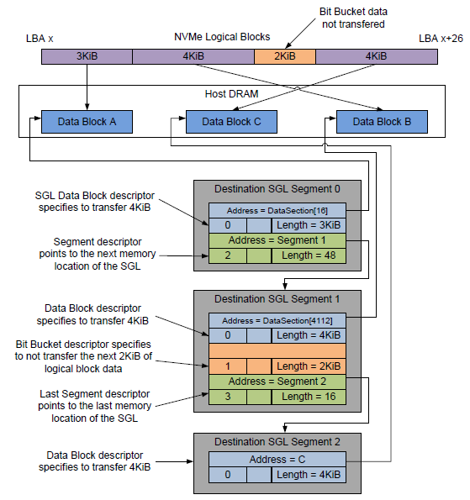

Slide 12

SQ Identifier: Indicates the Submission Queue to which the associated command was issued. SQ Head Pointer: Indicates the current Submission Queue Head pointer for the Submission Queue indicated in the SQ Identifier field. Status Field: Status for the command that has been completed. Phase tag: Identifies if the entry is new. Command identifier: Uniquely Identifies the command.
Completion Queue Entry

Slide 13
Thank you

